Slide 1
EE 262: SYNCHRONOUS MACHINES [Credit: 3] Compiled by Dr E. K. ANTO Edited & Presented by Dr F. B. EFFAH

Slide 2
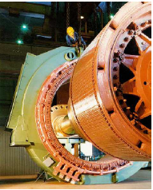
UNIT 1-DEFINITION AND FEATURES
Definition:
A synchronous machine is an AC machine whose rotor speed is the same as the angular speed of the revolving/rotating magnetic flux resulting from the interaction of two or more magnetic fields.
Synchronous machines have alternating currents (AC) in the stator windings (called armature) and
DC currents in the rotor windings (called field).

Slide 3
Constructional Features
1. Stator:
The stator unit is the stationary part of the machine and consists of the
stator frame or yoke and
the armature coils.
The stator frame or yoke serves the purposes of :
providing mechanical support for the poles
protection for the machine and
carrying the armature flux produced by the poles.

Slide 4
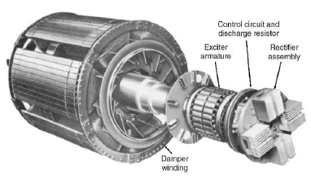
Constructional Features…cont’d
2. Rotor :
The rotor, which is the rotating part of the machine, is located on a shaft running on bearings, and is free to rotate between magnetic poles.
The rotor core is cylindrical or drum-shaped, and is built of steel laminations with slots to house the field windings.
In addition to the DC winding, the rotor carries the so-called damper windings (also called squirrel-cage winding).

Slide 5
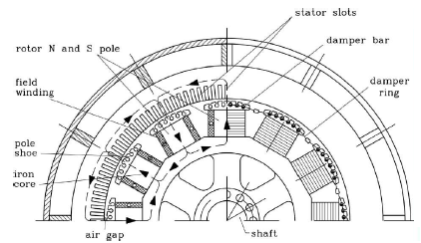
Constructional Features…cont’d
The damper winding serves the following functions:
produces forces which dampen the oscillation of the rotor, thereby reducing hunting (momentary speed fluctuations)
helps to start synchronous motors
maintains balanced 3-phase voltage under unbalanced load conditions.
improves parallel operation of salient-pole generators driven by internal-combustion engines.

Slide 6
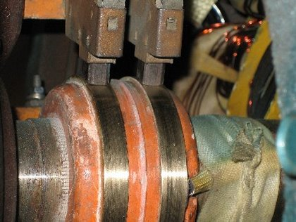
Constructional Features…cont’d
3. Slip-rings or collector rings:
The slip-ring is made of copper segments, and has the same functions in the motor as in a generator.
Its purpose is to facilitate the collection of current from the DC excitation source to the field windings.
4. Brushes and bearings:
These carry current from the external circuit to the commutator.
They are usually made of blocks of carbon or graphite, and are rectangular in shape.
They should slide freely in their holder so as to follow any irregularity in the commutator.

Slide 7
Types of Synchronous Machines:
Synchronous Generators (or Alternators)
Synchronous Motors (synchronous motors operating with load attached)
Synchronous Condensers (synchronous motors operating on no-load)

Slide 8
UNIT 2- SYNCHRONOUS GENERATORS
Types:
Salient-Pole Generators (Low-speed Generators)
Cylindrical-Rotor Generators (High-speed Generators)

Slide 9
Principle of Operation
Operates on the principle of electromagnetic induction. When the rotor is made to rotate by the turbine of the prime mover, the stator or armature conductors (being stationary) are cut by the rotated DC magnetic flux from the field coils on the rotor.
Hence they have induced emf produced in them. Because the magnetic poles are alternate N and S, they induce an emf and hence current in the armature conductors, which first flow in one direction and then in the other.

Slide 10
Principle of operation…cont’d.
Hence an alternating emf is induced in the stator windings whose frequency depends on the number of N and S poles moving past a conductor in one second and whose direction is given by Fleming’s Right-Hand Rule.

Slide 11
Stationary Armature
It is more desirable to have a stationary armature with the field poles rotating inside it, as this structure has several advantages;
Difficulty in insulating slip rings.
On a rotating armature, arc-overs and short circuits are apt to occur.
No slip rings are required in a stationary armature.
Easier to properly insulate a stationary armature

Slide 12
Rotating Magnetic Fields of Synchronous Generators

Slide 13
Distorting Effect of Armature Reaction Flux
The effect of the armature flux is to distort the main flux distribution in the air gap due to the field flux. This effect is known as armature reaction.
Counteracting Armature Reaction
-Increasing the reluctance of the cross-flux path
-compensating or pole-face winding.

Slide 14
Armature Reaction Reactance
The leakage reactance arising from the armature reaction is called armature reaction reactance.

Slide 15
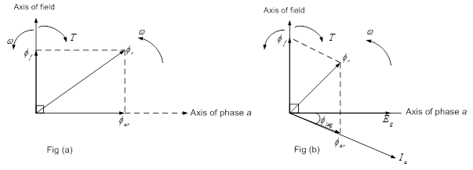
CYLINDRICAL-ROTOR SYNCHRONOUS GENERATORS
Phasor Diagrams

Slide 16
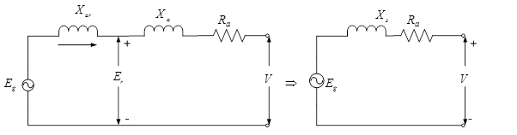
Equivalent Circuits

Slide 17
Steady-State Performance Characteristics of the Synchronous Machine
The tests performed to obtain these characteristics are the open-circuit and short-circuit tests.
These tests yield the open-circuit and short-circuit characteristics.

Slide 18
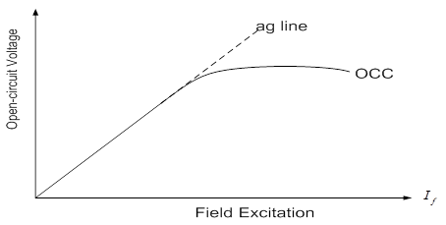
Open-Circuit Characteristics

Slide 19
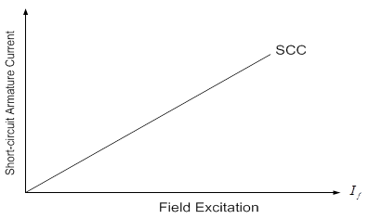
Short-Circuit Characteristics

Slide 20
Determination of the armature resistance
The armature resistance per phase can be measured directly by voltmeter and ammeter method or by using Wheatstone bridge.

Slide 21
Example 1
The following test results were obtained from a 3-phase, 6000 kVA, 6.6 kV star-connected, 2-pole, 50 Hz turbo alternator. With a field current of 125 A, the open circuit voltage is 8000 V at rated speed. With the same excitation and rated speed, the short-circuit current was 800 A. If at the rated full-load, the resistance drop is 3%, determine the following:
synchronous impedance
armature resistance
synchronous reactance

Slide 22
Solution 1
The synchronous impedance is calculated using the equation
ii. The voltage per phase is

Slide 23
Solution 1…cont’d
Full load current,
Resistance drop,
iii. Synchronous reactance,

Slide 24
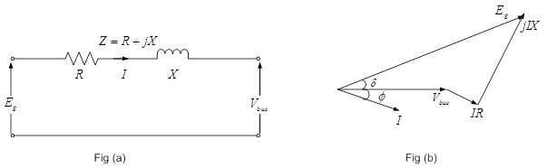
Output Power Delivered By Cylindrical-Rotor Synchronous Generator
Fig 11: (a) Circuit Diagram (b) Phasor Diagram

Slide 25
Output Power…cont’d.
The power delivered to the load or bus end is
In polar forms,

Slide 26
Output Power…cont’d.
The real part of the current is
But
Substituting Eqn (23) into (20), we obtain,

Slide 27
Output Power…cont’d.

Slide 28
Output Power…cont’d.
Where
And is usually a small angle.
Similarly,
With negligible resistance,
With negligible resistance and constant voltage, maximum power occurs at

Slide 29
Maximum Power Output From Cylindrical-Rotor Synchronous Generator
The maximum power per phase is given as:

Slide 30
Maximum current and power factor corresponding to maximum power output:

Slide 31
Example 3
A 3-phase 11 kV 5 MVA star-connected alternator has a synchronous impedance of
( per phase. Its excitation is such that the generated line emf is 12 kV. If the alternator is connected to an infinite busbar, determine the maximum output at the given excitation.

Slide 32
Solution 3
The generated phase voltage is
The terminal voltage per phase is
Since the armature resistance is NOT negligible, we need to calculate the internal angle

Slide 33
solution cont’d
Hence the maximum power output per phase is

Slide 34
Exercises on Maximum Power Output
Exercises 1, 2 and 3, Please refer to notes.

Slide 35
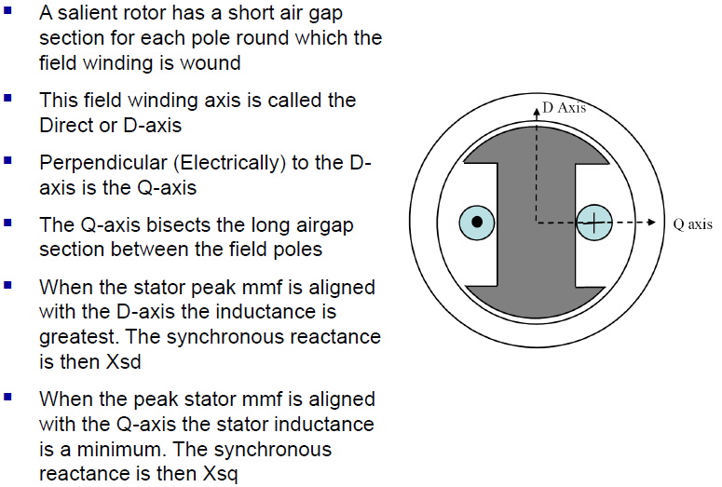
b) SALIENT-POLE GEOMETRY

Slide 36
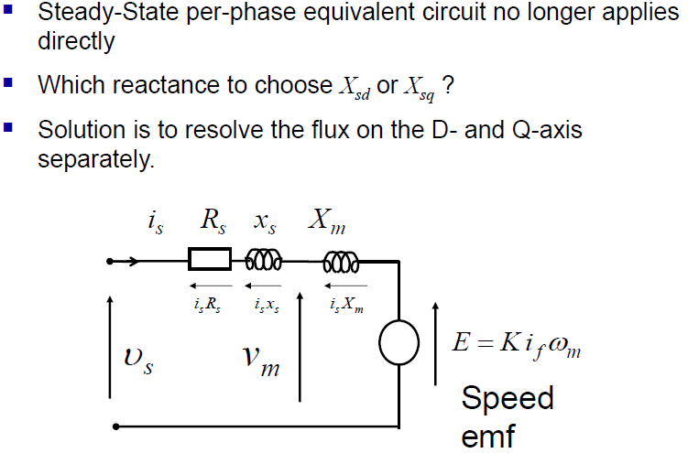
EQUIVALENT CIRCUIT OF SALIENT POLE SYNCHRONOUS MACHINE

Slide 37
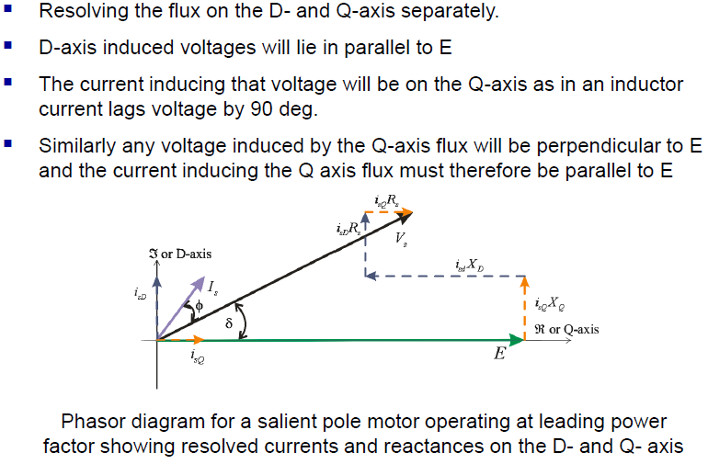
RESOLVING INTO D- AND Q- COMPONENTS

Slide 38
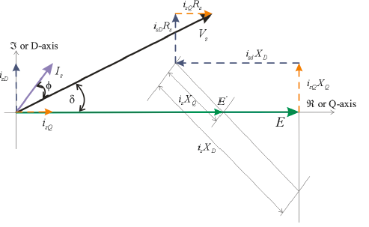
DETERMINING THE OPERATING CONDITIONS
Knowing the supply voltage and current of the machine and the D- and Q- axis reactances; to resolve the current Is into Isd and Isq we need to first determine the load angle
From the phasor diagram we can see that the load angle depends on Xsq and the magnitude of E on Xsd
E’ is introduced as the intercept of IsXq and E
This allows us to determine the load angle
The following slide shows how this is done

Slide 39
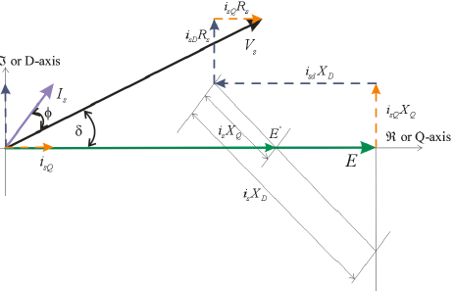
DETERMINING THE OPERATING CONDITIONS
The d- and q- components of current can now be found and the phasor diagram fully described
This can all be done by drawing the phasor diagram to scale using a ruler and a protractor
This can also be done analytically as follows

Slide 40
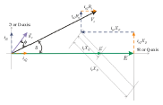
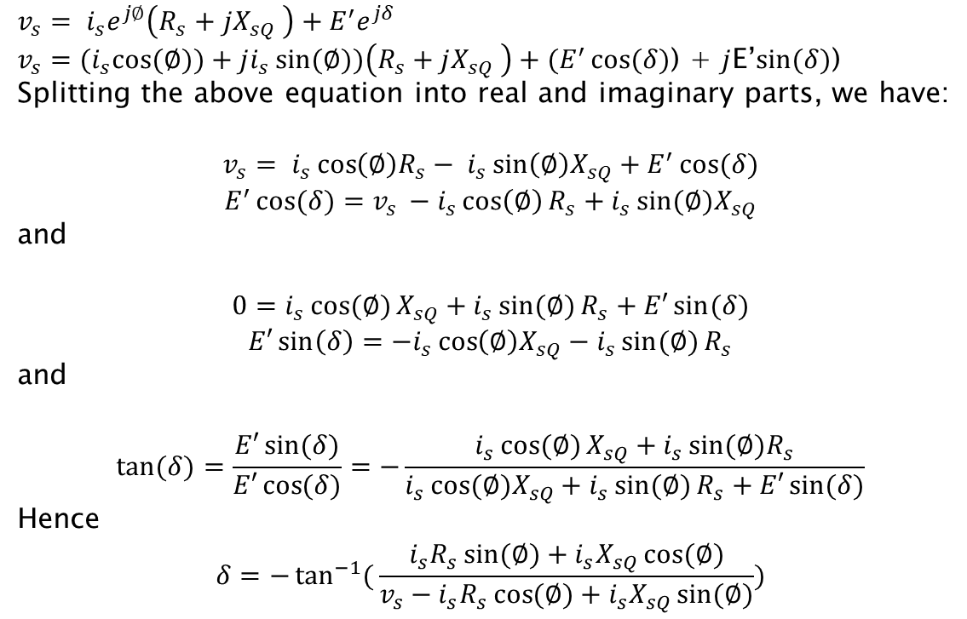
DETERMINING THE OPERATING CONDITIONS
$$v_{s}= i_{s}e^{j∅}\left(R_{s}+jX_{sQ} \right)+E^{′}e^{jδ}$$
$v_{s}={(i}_{s}\cos{(∅))}+ji_{s}\sin{(∅)})\left(R_{s}+jX_{sQ} \right)+(E^{′}\cos{(δ)}$) + $j$E’$\sin{(δ)}$)
Splitting the above equation into real and imaginary parts, we have:
$$v_{s}= i_{s}\cos\left(∅\right)R_{s}− i_{s}\sin\left(∅\right)X_{sQ}+E^{′}\cos{(δ)}$$
$$E^{′}\cos{(δ)}=v_{s }−i_{s}\cos\left(∅\right)R_{s}+i_{s}\sin{(∅)X_{sQ}}$$
and
$$0=i_{s}\cos{(∅)}X_{sQ}+i_{s}\sin{(∅)}R_{s}+E′\sin{(δ)}$$
$$E′\sin\left(δ\right)=−i_{s}\cos\left(∅\right)X_{sQ}−i_{s}\sin{(∅)}R_{s}$$
and
$$\tan{(δ)}=\frac{E′\sin{(δ)}}{E′\cos{(δ)}}=−\frac{i_{s}\cos{(∅)}X_{sQ}+i_{s}\sin{(∅)R_{s}}}{i_{s}\cos{(∅)X_{sQ}}+i_{s}\sin{(∅)}R_{s}+E′\sin{(δ)}}$$
Hence
$$δ=−\tan^{−1}({\frac{i_{s}R_{s}\sin{(∅)}+i_{s}X_{sQ}\cos{(∅)}}{v_{s}−i_{s}R_{s}\cos{(∅)}+i_{s}X_{sQ}\sin{(∅)}})}$$

Slide 41
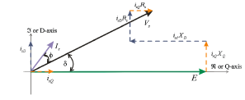

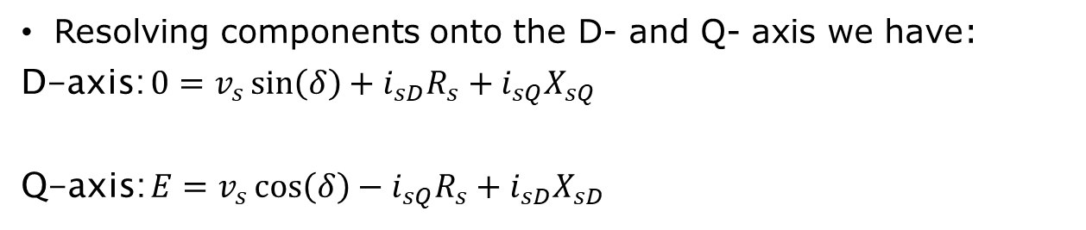
DETERMINING THE OPERATING CONDITIONS
Having determined the load angle we can write:
$$i_{sD}=i_{s}\sin{(∅−δ)}$$
$$i_{sQ}=i_{s}\cos{(∅−δ)}$$
Resolving components onto the D- and Q- axis we have:
D-axis: $0=v_{s}\sin\left(δ\right)+i_{sD}R_{s}+i_{sQ}X_{sQ}$
Q-axis: $E=v_{s}\cos\left(δ\right)−i_{sQ}R_{s}+i_{sD}X_{sD}$

Slide 42
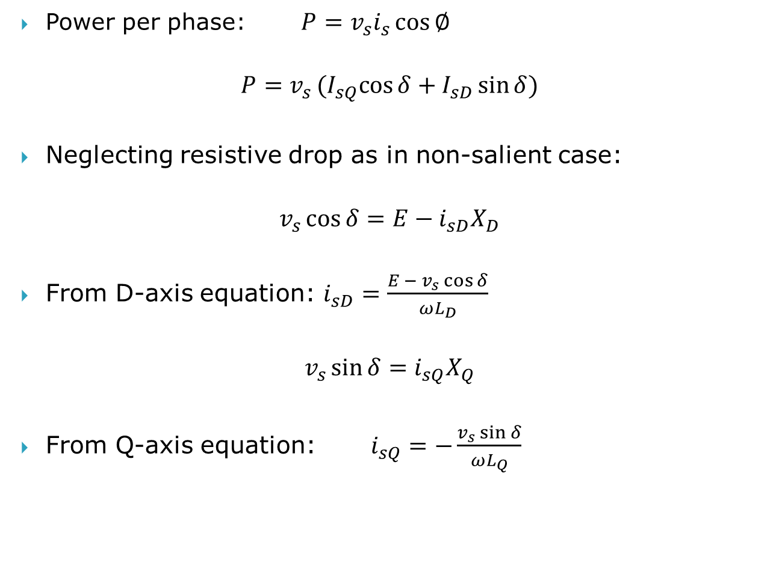
EVALUATION OF POWER
Power per phase: $P=v_{s}i_{s}\cos{∅}$
$$P=v_{s}(I_{sQ}cos{δ+I_{sD}\sin{δ})}$$
Neglecting resistive drop as in non-salient case:
$$v_{s}\cos{δ}=E−i_{sD}X_{D}$$
From D-axis equation: $i_{sD}=\frac{E − v_{s}\cos{δ}}{ωL_{D}}$
$$v_{s}\sin{δ}=i_{sQ}X_{Q}$$
From Q-axis equation: $i_{sQ}=−\frac{v_{s}\sin{δ}}{ωL_{Q}}$

Slide 43
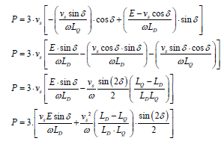
EVALUATION OF POWER
Substituting and evaluating for 3-phases:

Slide 44
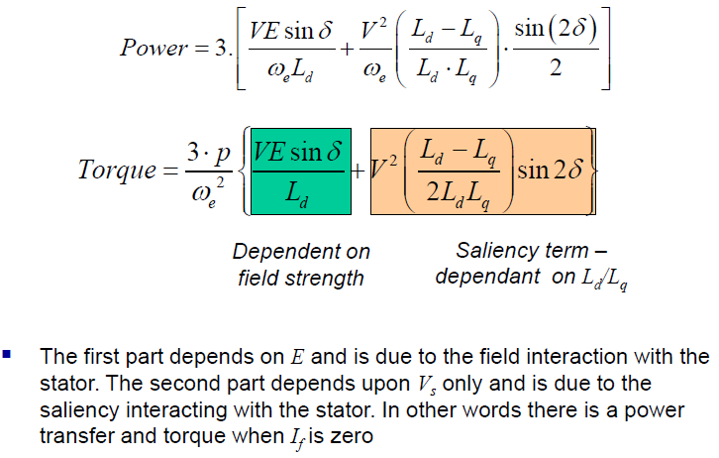
POWER LOAD ANGLE RELATIONSHIP

Slide 45
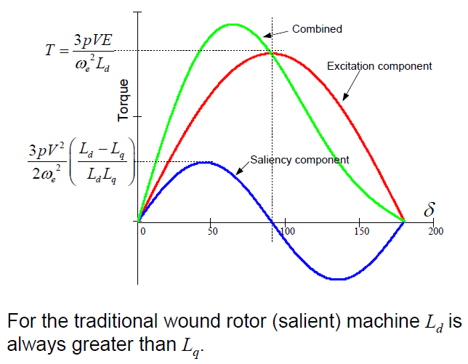
POWER LOAD ANGLE RELATIONSHIP

Slide 46
Example 4
The reactances and of a salient-pole synchronous generator are 1.00 and 0.60 p.u., respectively. The armature resistance is negligible. Compute the excitation voltage when the generator delivers rated kVA at 0.80 pf lagging current, and rated terminal voltage.
**Please refer to notes for solution 4.

Slide 47
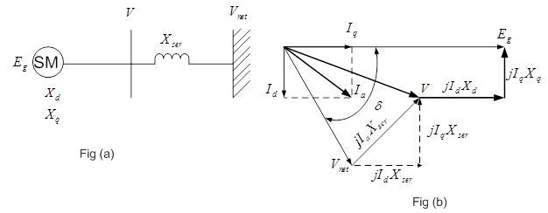
Output Power Delivered by Salient-Pole Synchronous Generator
Salient-Pole Synchronous Machine and Series Impedance
(a) Single-Line Diagram (b) Phasor Diagram

Slide 48
Output Power…cont’d.
Hence
Equation 41
Example 5
Example 6

Slide 49
Voltage regulation
It is a known fact that with a change in load, there is a change in terminal voltage of an alternator.
The magnitude of this change depends not only on the load but also on the load power factor.
The voltage regulation is defined as:
(42)

Slide 50
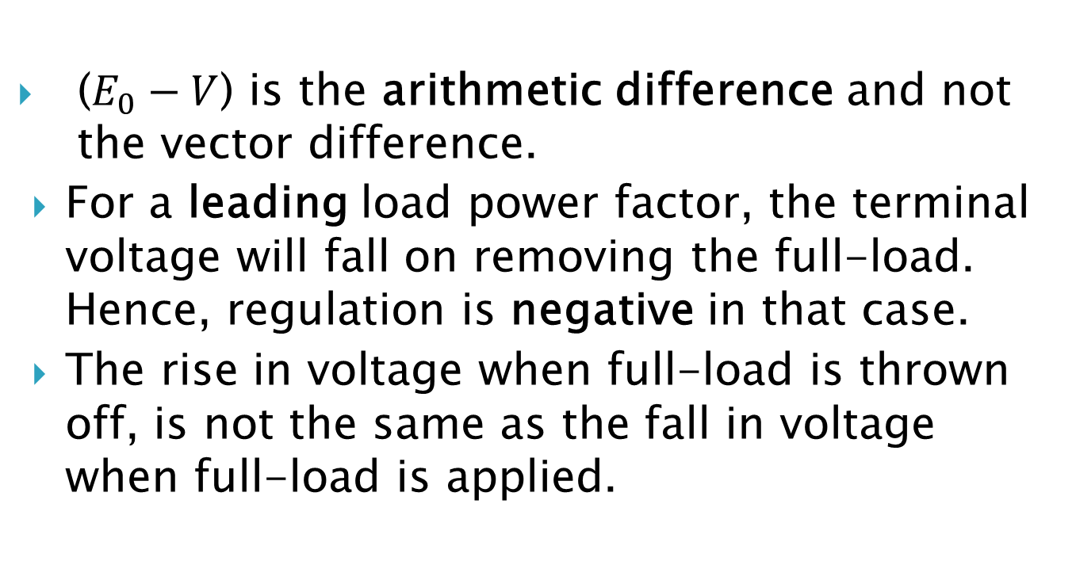
Notes on Eqn (42)
($E_{0}−V$) is the arithmetic difference and not the vector difference.
For a leading load power factor, the terminal voltage will fall on removing the full-load. Hence, regulation is negative in that case.
The rise in voltage when full-load is thrown off, is not the same as the fall in voltage when full-load is applied.

Slide 51
Determination of Voltage Regulation
Voltage Regulation of a generator depends on:
armature resistance
synchronous reactance
power factor.
In small machines, the voltage regulation is found by direct loading.

Slide 52
Voltage Regulation…cont’d.
In large machines, the voltage regulation is found by some indirect methods:
Synchronous Impedance or EMF Method (due to Behn Eschenberg)
Ampere-Turn or MMF Method (due to Rothert)
Zero Power Factor or Potier Method (as name implies, due to Potier)

Slide 53
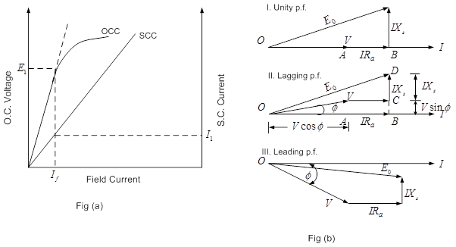
Indirect Method 1-Synchronous Impedance or EMF Method
The general data required in this method are the OCC, SCC and the synchronous impedance.

Slide 54
Example 7
Example 8
Example 9
**Please refer to notes

Slide 55
Steady-State Operating Characteristics of Synchronous Generators
The main characteristics are :
Terminal Voltage Characteristics (curves for a given power factor)
Compounding Curves (curves at rated terminal voltage )
Reactive-Active Power Capability Curves (curves for a given power factor)

Slide 56
i. Terminal Voltage Characteristics (V-Ia) Curves For a Given Power Factor
It shows the variation of terminal voltage with load (or armature) current for a given power factor when the generator is driven at constant speed and excited with constant current.

Slide 57
(V-Ia) curves…cont’d.

Slide 58
Terminal voltage characteristics…cont’d.
Using the cosine rule,
we obtain
from the equation
Dividing through by

Slide 59
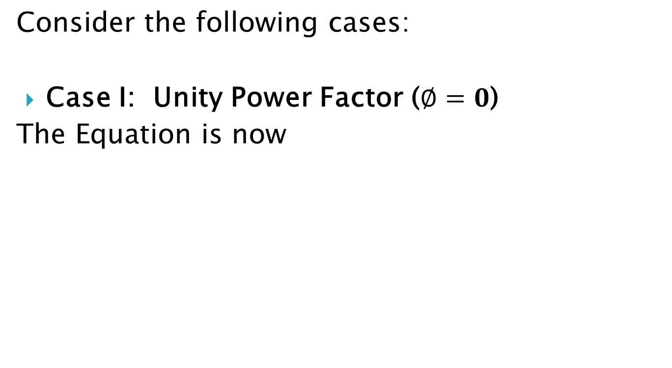
Terminal voltage characteristics…cont’d.
Consider the following cases:
Case I: Unity Power Factor ($∅=0$)
The Equation is now

Slide 60
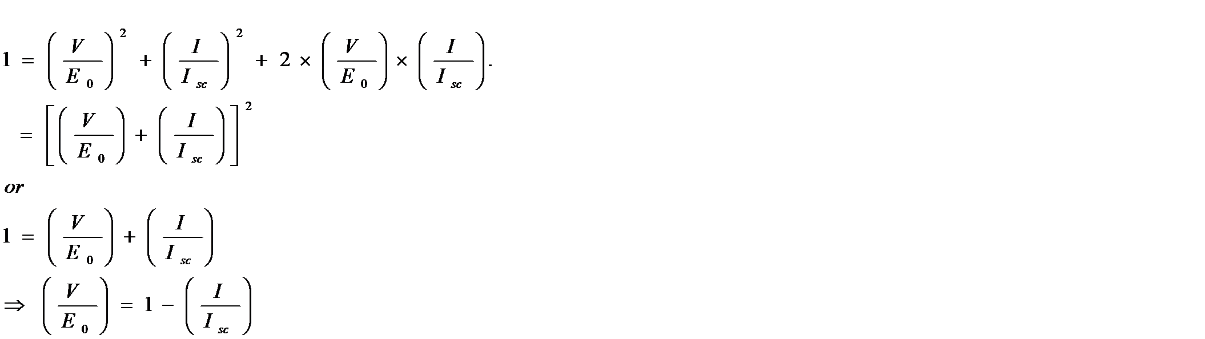
Terminal voltage characteristics…cont’d.
Case II: Zero Power Factor Lagging
φ = 90⁰ and sin φ = 1

Slide 61
Terminal voltage characteristics…cont’d
Case III: Zero Power Factor Leading
φ = -90⁰ and sin φ = -1.

Slide 62
Compounding Curves
The curve that shows the field current required to maintain rated terminal voltage as the constant-power-factor-load is varied is known as a compounding curve.

Slide 63
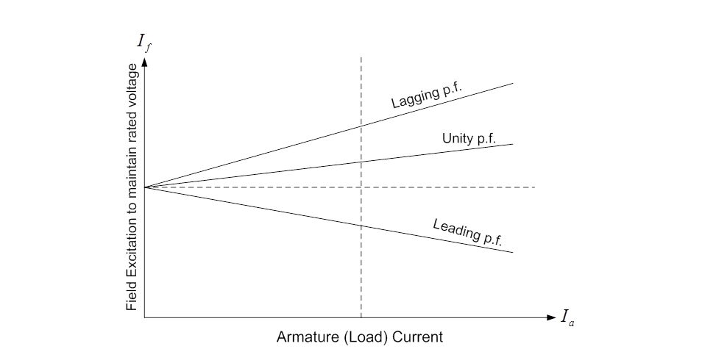
Compounding Curves…cont’d.
Fig 20: Generator Compounding Curves

Slide 64
Compounding Curves…cont’d.
If the field current is held constant while the load varies, the terminal voltage will vary.
All unity- and lagging-pf loads will require an increase of excitation with increase of load current
Low leading-pf loads will require a decrease of excitation with increase of load current.

Slide 65
Reactive-Active Power Capability Curves (Q –P Curves for a given pf)
Fig 21: Reactive-Active Power Capability Curves of a Turbo-generator

Slide 66
Exercises on Voltage Regulation
Exercise 4
Exercise 5

Slide 67
UNIT 3-PARALLELING OF GENERATORS FOR LOAD SHARING
Reasons
1) Local or regional power demand may exceed the power of a single available generator.
2) Parallel generators allow one or more units to be shut down for scheduled or emergency maintenance without having to interrupt power supply to the load.

Slide 68
Paralleling of Generators…cont’d.
3) Generators operate at reduced efficiency at light or part load. And so, shutting down one or more generators allows the remaining load to be supplied by fewer machines that are efficiently loaded.
4) Load growth can be handled by added machines without disturbing the original installation.

Slide 69
Paralleling of Generators…cont’d
5) Available machine prime movers and generators can be matched for economic or optimal utilization in terms of economy and flexibility of use.

Slide 70
Requirements for Generator Paralleling
1) The terminal voltages must be the same at the paralleling or interconnection or tie point or junction, even though not the same at the generators.
2)The phase sequences or rotations for three-phase generators must be the same at the paralleling point.
3) The line frequencies must be identical or approximately equal at the paralleling point.

Slide 71
Requirements for Generator Paralleling …cont’d.
4) With reference to the load, the voltage of the incoming generator must be in phase with that of the running machine
5) The incoming generator must generate a voltage wave of approximately the same shape as that of the running generator.

Slide 72
Synchronization
At the time of synchronization, all the conditions for paralleling two or more generators must be met;
effective terminal voltage of the incoming generator must be exactly equal to that of the others, or of the busbar connecting them.
frequencies should be the same, although it is more desirable that the frequencies at the instant of paralleling be almost, but not quite, identical.
phase sequence or rotation of the running and incoming generators must be the same.
individual phase voltages which are to be connected to each other must be in exact phase opposition. This is the same as saying that the terminals of DC generators must be connected positive to positive (+ to +) and negative to negative (- to -).

Slide 73
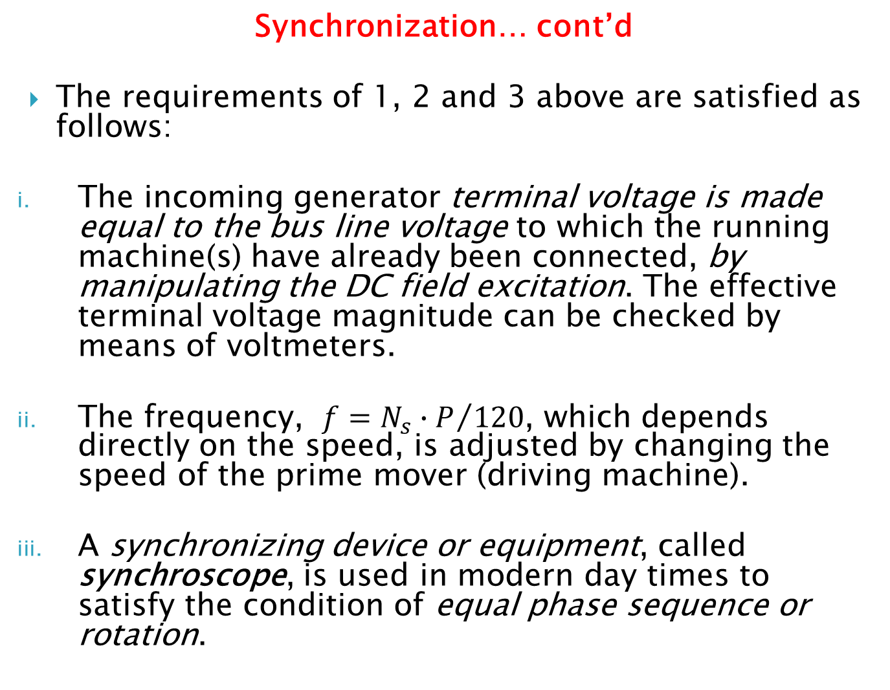
Synchronization… cont’d
The requirements of 1, 2 and 3 above are satisfied as follows:
The incoming generator terminal voltage is made equal to the bus line voltage to which the running machine(s) have already been connected, by manipulating the DC field excitation. The effective terminal voltage magnitude can be checked by means of voltmeters.
The frequency, $f={N_{s}∙P}/{120}$, which depends directly on the speed, is adjusted by changing the speed of the prime mover (driving machine).
A synchronizing device or equipment, called synchroscope, is used in modern day times to satisfy the condition of equal phase sequence or rotation.

Slide 74
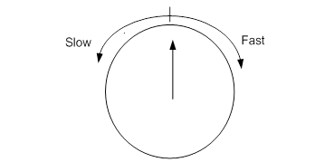
Synchroscope Method for Synchronization
In practice, in large central power station installations, generators are synchronized by means of an indicating instrument called the synchroscope.

Slide 75
Load Sharing or Allocation
Any two or more generators that have been synchronized together can be made to share the active-power and reactive-power load by appropriate adjustments of the prime-mover throttles and field rheostats respectively.
In discussing load distribution among two paralleled generators, we shall be looking at the:
effect of change in field excitation
effect of change in mechanical driving torque of the prime mover

Slide 76
Effect of Change in Excitation – Reactive Load Sharing
Concept of Synchronizing Current

Slide 77
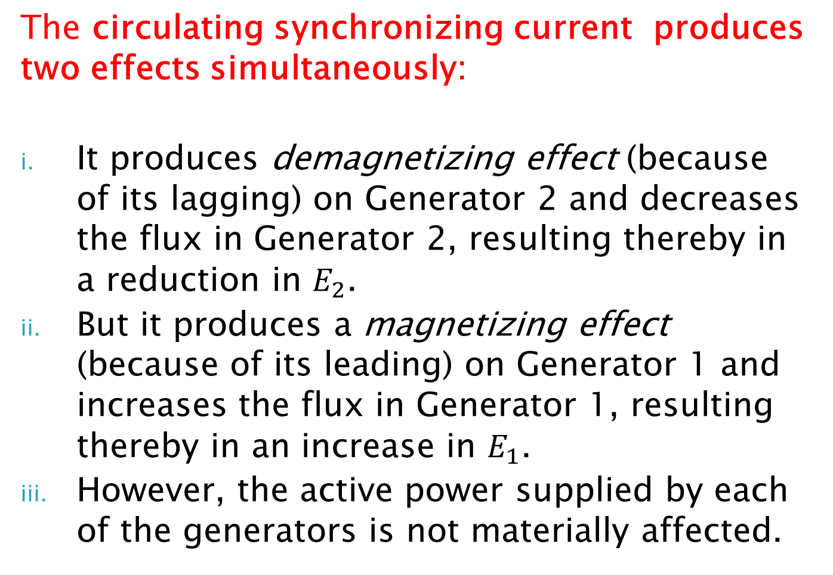
The circulating synchronizing current produces two effects simultaneously:
It produces demagnetizing effect (because of its lagging) on Generator 2 and decreases the flux in Generator 2, resulting thereby in a reduction in $E_{2}$.
But it produces a magnetizing effect (because of its leading) on Generator 1 and increases the flux in Generator 1, resulting thereby in an increase in $E_{1}$.
However, the active power supplied by each of the generators is not materially affected.

Slide 78
2. Effect of Change in Field Excitation for Paralleled Generators
Consider two already synchronized generators each supplying current to an external load.
If the field excitation of one generator is changed, a reactive circulating current (synchronizing current) results, that changes the reactive kVA-output and hence the power factor at which each of the generator is producing. See Fig 24 in next slide.

Slide 79
Change in field excitation…cont’d.
Fig 24: Effect of Change in Excitation for Two Paralleled Generators

Slide 80
Change in field excitation…cont’d.
The vectors and are shown in-phase because they are represented relative to the load. The synchronous current circulating through Generator 1 is leading , and that through Generator 2 is lagging .

Slide 81
Effect of Change in Field Excitation for Paralleled Generators…cont’d.
If two generators in parallel supply equal current and have the same power factor, and the field excitation of one of them is changed, a reactive circulating current (synchronizing current) is established.
The following points must be noted:
If excitation is changed, only the power factor at which the load is delivered by the respective generators is changed.

Slide 82
points to note…cont’d.
ii. By keeping the input of the prime mover of a generator constant, any change in field excitation merely changes the reactive-kVA component of the output and the terminal voltage, but not the active-kW output.
iii. A generator cannot, therefore be made to take an active load merely by increasing its field excitation.

Slide 83
3. Effect of Change in Prime Mover Input – Active Load Sharing
The load taken up by a generator directly depends on its driving mechanical torque
Generators in parallel tend to remain synchronized. If the speed of one is increased, it immediately supplies more load and slows down, and the other supplies less load and speeds up, so that the speeds of the alternators again become equal.
By increasing the input to its prime mover, a generator can be made to take a greater share of the load, though at different power factor

Slide 84
Active Load sharing ...cont’d. The exact sharing of active power between synchronous generators is determined by their speed-load or frequency-load characteristics, which take the form shown in Fig 25.

Slide 85
Active Load sharing ...cont’d.
For steady state operation, the frequencies of the two machines must be equal. Hence,
The slope, is termed the drooping of the characteristics.
Changing the speed-load characteristic changes the load sharing, and this involves an alteration to the governor setting.

Slide 86
Examples and Exercises
Example 10
Example 11
Exercises on Parallel Operation of Alternators

Slide 87
Synchronizing Power and Torque – Effect of Increasing the Driving Mechanical Torque

Slide 88
Effect of Increasing Prime Mover Power Input to One of Two Alternators Supplying Currents and Different Power Factors
If the power input to the prime mover of Machine 2 is increased, then its emf vector will swing ahead by a certain angle as shown in Fig 27.

Slide 89
Increasing prime mover input…cont’d.

Slide 90
Synchronizing Power
If additional power input or torque is supplied to say machine 2 causing it to accelerate, its induced voltage will advance by a small angle δ ahead that of machine 1, and machine 2 will take a greater part of the load as depicted in the following diagram.

Slide 91
Synchronising power…cont’d.

Slide 92
Synchronising power…cont’d.

Slide 93
Active Load sharing ...cont’d.

Slide 94
The total synchronizing power for 3-phases is
The synchronizing power is produced because the armature impedance is highly inductive.
The synchronizing power is produced even when their emfs are not equal.
Alternators in parallel tend to remain synchronized. If the speed of one is increased, it immediately supplies more load and slows down, and the other supplies less load and speeds up, so that the speeds of the alternators again become equal.

Slide 95
Synchronizing Torque
can be caused by:
a change to the mechanical input from the prime mover or
a change of armature current due to circuit conditions or
a change of excitation.

Slide 96
Synchronizing Torque…cont’d.

Slide 97
Synchronizing Torque…cont’d

Slide 98
Examples
Example 12
Example 13
Example 14

Slide 99
The number of electrical degrees equals times the number of mechanical degrees in any machine, where is the number of poles.

Slide 100
Hunting of Alternators
When two alternators are operating in parallel, any instantaneous reduction in the angular velocity of one machine, due to variations in the load, causes:
A change in load division between them and
A synchronizing current to circulate
Hunting generally occurs in alternators driven by reciprocating engines, because the driving torque of reciprocating engines is not uniform in a revolution of the flywheel.
The torque output will pulsate if the prime mover of one of the alternators is a reciprocating engine.

Slide 101
Hunting of Alternators…cont’d.
Turbo-generators seldom hunt, because the prime mover supplies a uniform driving torque.
It is customary to specify, for alternators to be operated in parallel, the allowable torque-angle variation.
Machines driven by internal combustion engines must have large flywheels or heavy damping windings to prevent excessive oscillations.

Slide 102
Reducing Hunting in Alternators
Dampening of the oscillations by use of a heavy squirrel-cage dampening winding placed on the field poles
Changing the natural period of vibration of the machine by changing the flywheel (a heavier flywheel usually gives a more dampening effect).
Dampening the governor, if the oscillations are started by the action of the governor.

Slide 103
Exercises on Synchronizing Power and Torque
Exercise 7
Exercise 8

Slide 104
UNIT 4— THREE-PHASE SYNCHRONOUS MOTORS
The synchronous motor is one type of three-phase AC motor, which operates at a constant speed from no-load to full-load.

Slide 105
Constructional Features and Principles of Operation of Synchronous Motors
Laminated stator core with three-phase stator (armature) windings.
Rotating DC field windings on the rotor, complete with slips rings,
Brushes and brush holders,
Two-end shields to house the bearings that support the shaft.

Slide 106
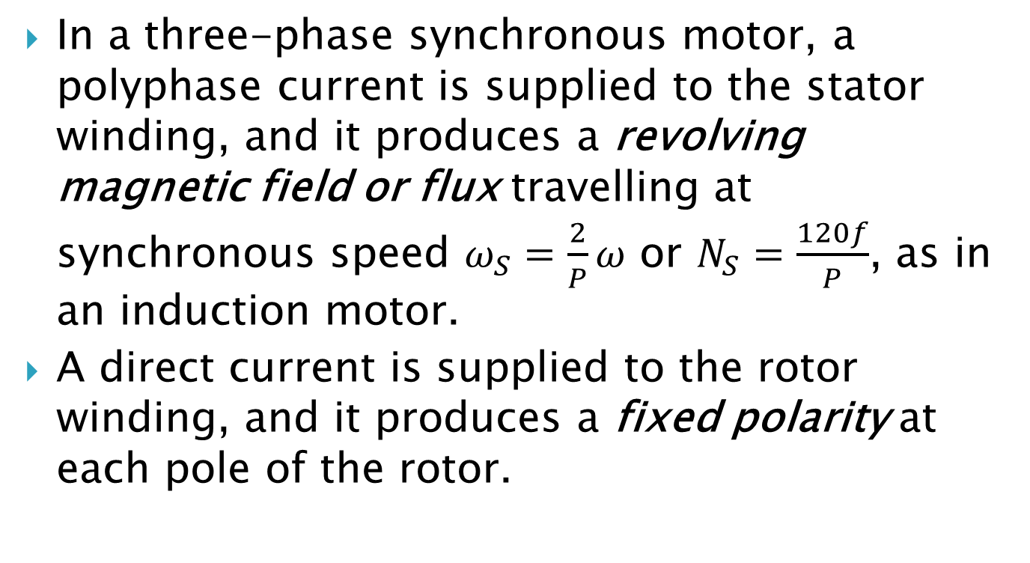
Principle of Operation of Synchronous Motors
In a three-phase synchronous motor, a polyphase current is supplied to the stator winding, and it produces a revolving magnetic field or flux travelling at synchronous speed $ω_{S}=\frac{2}{P}ω$ or $N_{S}=\frac{120f}{P}$, as in an induction motor.
A direct current is supplied to the rotor winding, and it produces a fixed polarity at each pole of the rotor.

Slide 107
Principle of Operation…cont’d.

Slide 108
Why Synchronous Motors Are Not Self-Starting
The revolving stator magnetic field tends to pull the rotor poles first in one direction and then in the other direction, and as a result, the starting torque is zero.
The synchronous motor is thus inherently not self-starting, unless some starting mechanisms or techniques are employed.

Slide 109
Starting of Synchronous Motors – Use of Damper Windings as Squirrel-Cage Induction Motor
It is practically impossible to start a synchronous motor with its DC field energized, as the net starting torque is zero.
A squirrel-cage winding is generally placed on the rotor poles of a synchronous motor to make the machine self-starting.

Slide 110
Necessary Precaution When Starting Synchronous Motor – Use of External Starting Resistance
The rotor winding has a large number of turns and therefore an extremely high voltage is induced in the many turns of the field winding, which will appear between its terminals.
A high-peak terminal voltage also appears when the rotor circuit of a machine in operation is opened.

Slide 111
Precautions…cont’d.
These high voltages will puncture the insulation, unless the winding is highly insulated.
In practice, to contain this phenomenon, the DC field winding is short-circuited during the starting period through a very low resistance connected to the switch of the rotor circuit.

Slide 112
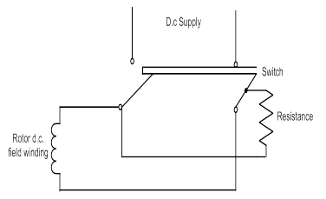
Precautions…cont’d.
Fig 29: Precautionary Measure Taken During The Starting of Synchronous Motor

Slide 113
Synchronous Capacitors
Synchronous capacitors are actually synchronous motors that are operating on no-load (without a connected mechanical load) for the purpose of power factor correction or improving the voltage regulation of a transmission line.

Slide 114
Advantages of Synchronous Condensers over Capacitors
The ease with which the power factor can be controlled by either producing or absorbing reactive power.
Their performance can be regulated continuously and smoothly over a wide range.
They are more practical than capacitors.
The speed of the synchronous motor is constant and independent of load.

Slide 115
Disadvantages of Synchronous Condensers compared with Capacitors
Some arrangement must be provided for starting and synchronizing the motor
A DC supply is necessary for the rotor excitation.
Synchronous motors contribute to the current flowing into a short-circuit fault on the system, and may call for additional expenditure in switchgear.
They are more expensive that static capacitors.

Slide 116
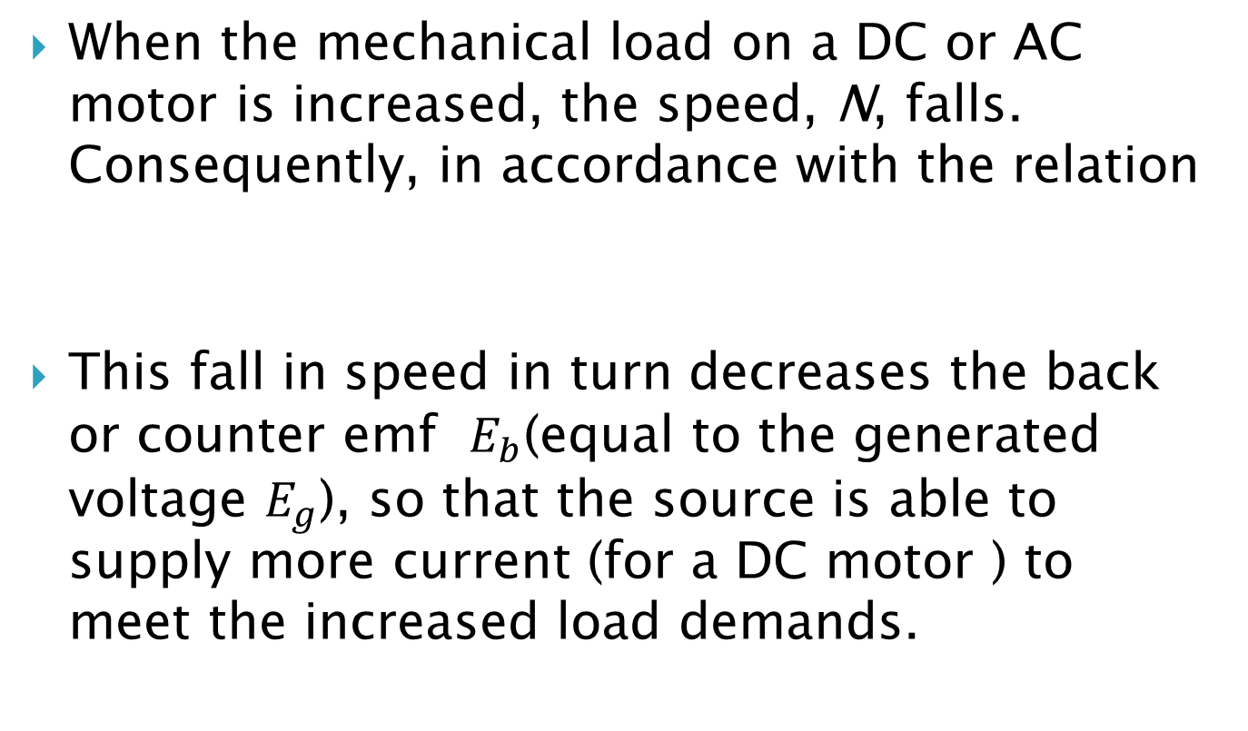
Effect of Loading on the Synchronous Motor
When the mechanical load on a DC or AC motor is increased, the speed, N, falls. Consequently, in accordance with the relation
This fall in speed in turn decreases the back or counter emf $E_{b}$(equal to the generated voltage $E_{g}$), so that the source is able to supply more current (for a DC motor ) to meet the increased load demands.

Slide 117
Torque Angle at No-Load
At no-load, the stator and rotor pole centres are directly in line with each other.

Slide 118
Torque Angle at Rated Load

Slide 119
Torque Angle…cont’d.
The torque angle increases with the increase in load.
For increasing load with a constant value of generated or back emf , the phase angle φ increases in lagging direction.

Slide 120
Operating Characteristics of Synchronous Motors
Electrical utility companies usually charge industries for operating at low power factors below a specified level, say, 0.9.
Utility companies attempt to correct the power factor of their systems.
2 methods can be used:
Power-factor corrective capacitors
Three-phase synchronous motors

Slide 121
V-Curves or Compounding Curves of the Synchronous Motor (Effect of Rotor Field Excitation on Armature Current and Power Factor for Constant Mechanical Load )
Three operational conditions may exist, depending on the amount of excitation applied to the rotor:
Under-excitation – operation at lagging power factor (inductive effect)
Normal excitation – operation at unity power factor (resistive effect)
Over-excitation – operation at leading power factor (capacitive effect)

Slide 122
Since the speed is constant, the induced voltage decreases.

Slide 123
For a given load at unity power factor, the resultant voltage and therefore the stator current are minima.

Slide 124
If the field excitation is still further increased, the induced voltage is increased, the current increases and leads the applied voltage.
Hence for a given load, the power factor is governed by the dc field excitation. A weak field excitation produces a lagging current and a strong field produces a leading current.

Slide 125
Characteristic curves

Slide 126
Observations about V-curves of Synchronous Motor
Note the variation of stator current drawn by the synchronous motor as rotor dc excitation current varies
The situations shown on the graph of Fig 33 (a) above indicate no-load, half-load and full-load conditions with power factors equal to unity, 0.8 leading and 0.8 lagging.
The graph of Fig 33 (b) shows variation of power factor with changes in rotor dc excitation under three different load conditions (no-load, half-load and full-load).

Slide 127
Observations…cont’d.
Observe that for a given load or output power, the stator current is minimum when the power factor equals unity.
The dashed lines are loci of constant power factor (0.8 leading, unity and 0.8 lagging).
Points to the right of the unity power factor compounding curve correspond to over-excitation and leading current input
Points to the left of the unity power factor compounding curve correspond to under-excitation and lagging current input
The synchronous motor compounding curves, as in Fig 33 (a) above, are very similar to the generator compounding curve.

Slide 128
Circuit and Phasor Diagram for Over-Excitation and Leading Pf

Slide 129
Generated emf per Phase in Synchronous Motor

Slide 130
Mechanical Power per Phase Developed By Synchronous Motor

Slide 131
Maximum Mechanical Power Developed in Synchronous Motor

Slide 133
Mechanical torque

Slide 134
Mechanical power…cont’d.

Slide 135
Maximum Power from Synchronous Motor

Slide 136
Circuit and Phasor Diagram for Normal Excitation and Unity pf in Synchronous Motor

Slide 137
Examples
Example 15
Example 16
Example 17
Example 18
Example 19

Slide 138
Examples on Synchronous Condensers
Example 20
An industrial plant has a load of 1500 kVA at an average pf of 0.6 lagging neglecting all output losses. Calculate the required kVA rating of the synchronous condenser which when connected to the plant will improve the pf of the plant to unity pf. Find also the total load in kW.

Slide 139
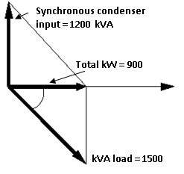
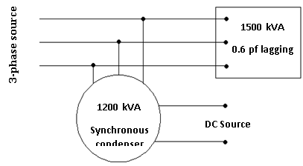
Examples on Synchronous Condensers
Solution Ex.20

Slide 140
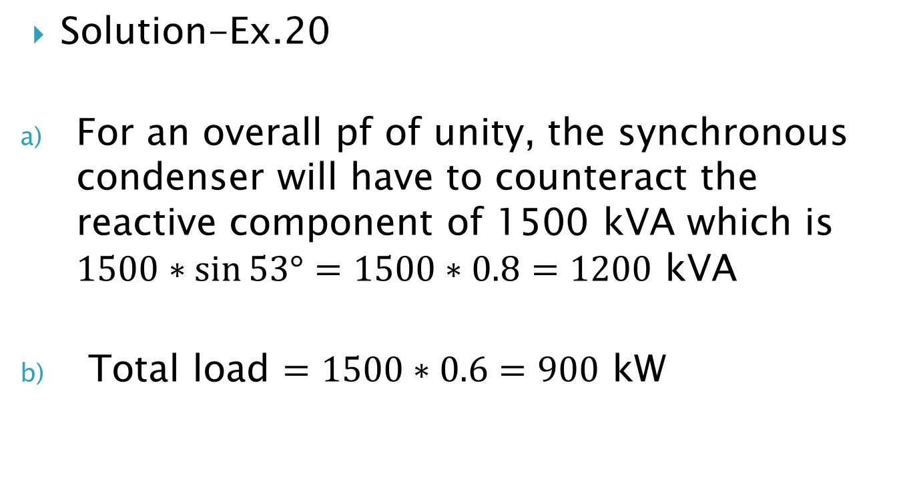
Examples on Synchronous Condensers
Solution-Ex.20
For an overall pf of unity, the synchronous condenser will have to counteract the reactive component of 1500 kVA which is $1500∗\sin{53°=1500∗0.8=1200}$ kVA
Total load $=1500∗0.6=900$ kW

Slide 141
Examples on Synchronous Condensers
Example 21
It is desired to purchase a synchronous condenser to correct the 2400 kVA 0.67 lagging pf load in an industrial plant to 0.95 lagging. Neglecting losses, calculate a) the kVA input rating of the required synchronous condenser; b) the total kVA of the plant.

Slide 142
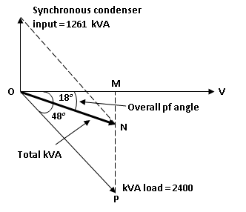
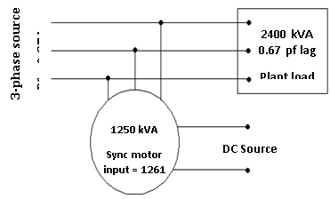
Examples on Synchronous Condensers
Solution Ex.21

Slide 143
Examples on Synchronous Condensers
Solution Ex.21
Referring to the fig. above;
OP = 2400 kVA
Angle POM = 48º (since cos 48º = 0.67)
Angle NOM = 18º (since cos 18º = 0.95)
MP = OP x sin 48º = 2400 x 0.743 = 1783 kVA
OM = OP x cos 48º = 2400 x 0.67 = 1608 kVA
Therefore MN = OM x 0.325 = 1608 x 0.325 = 522 kVA
Synchronous condenser rating = MP – MN = 1783 – 522 = 1261 kVA
b) Total kVA

Slide 144
Dual-purpose Synchronous Motor
A synchronous condenser is a synchronous motor operating without mechanical load but with strong dc excitation. For these reasons it is generally modified mechanically and electrically from the usual motor designs.
Having no mechanical output, it has no shaft extension nor is the shaft diameter as large as those required by loaded motors.
More usually, the synchronous motor is used for the dual purpose of delivering a mechanical load and correcting an otherwise low lagging pf.

Slide 145
Dual-purpose Synchronous Motor
This is particularly true in systems that must supply power to a considerable number of lightly loaded induction motors and other types of induction equipment.
In such plants it is usually advantageous to install a synchronous motor to raise the pf to a suitable value and at the same time to have it drive some constant speed load such as a dc generator, a large pump or other continuous-duty equipment.

Slide 146
Examples on Dual-Purpose Synchronous Motors
Example 22
An industrial plant has an average load of 900 kW at a pf of 0.6 lagging. A synchronous motor is to be installed to drive a dc generator and to raise the overall pf to 0.92. If preliminary estimates indicate that the input to the synchronous motor will be about 250 kW, calculate a) its kVA input rating and b) the pf at which it will operate.

Slide 147
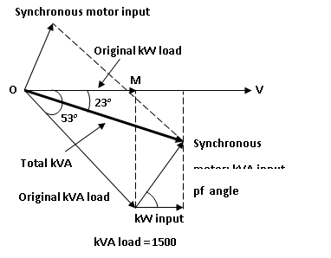
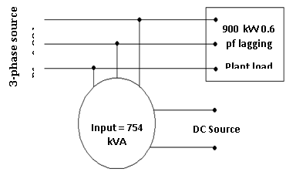
Examples on Dual-purpose Synchronous Motors
Solution Ex.22

Slide 148
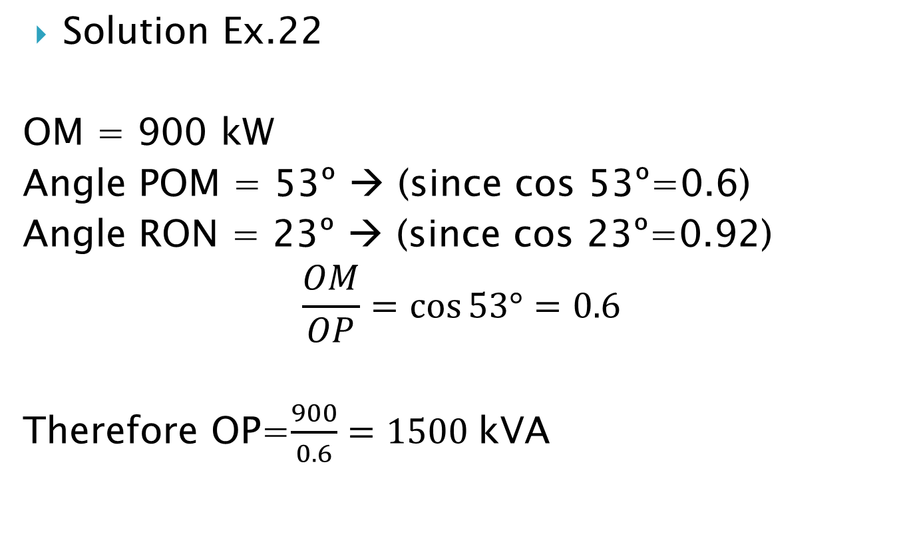
Examples on Dual-purpose Synchronous Motors
Solution Ex.22
OM = 900 kW
Angle POM = 53º → (since cos 53º=0.6)
Angle RON = 23º → (since cos 23º=0.92)
$$\frac{OM}{OP}=\cos{53°=0.6}$$
Therefore OP=$\frac{900}{0.6}=1500$kVA

Slide 149
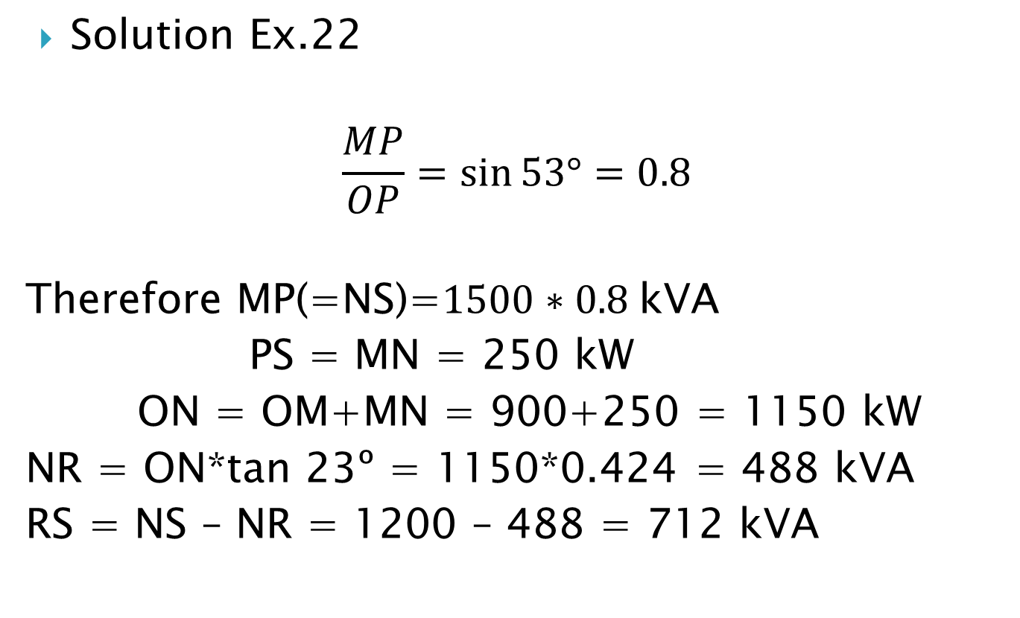
Examples on Dual-purpose Synchronous Motors
Solution Ex.22
$$\frac{MP}{OP}=\sin{53°=0.8}$$
Therefore MP(=NS)=$1500∗0.8$kVA
PS = MN = 250 kW
ON = OM+MN = 900+250 = 1150 kW
NR = ON*tan 23º = 1150*0.424 = 488 kVA
RS = NS – NR = 1200 – 488 = 712 kVA

Slide 150
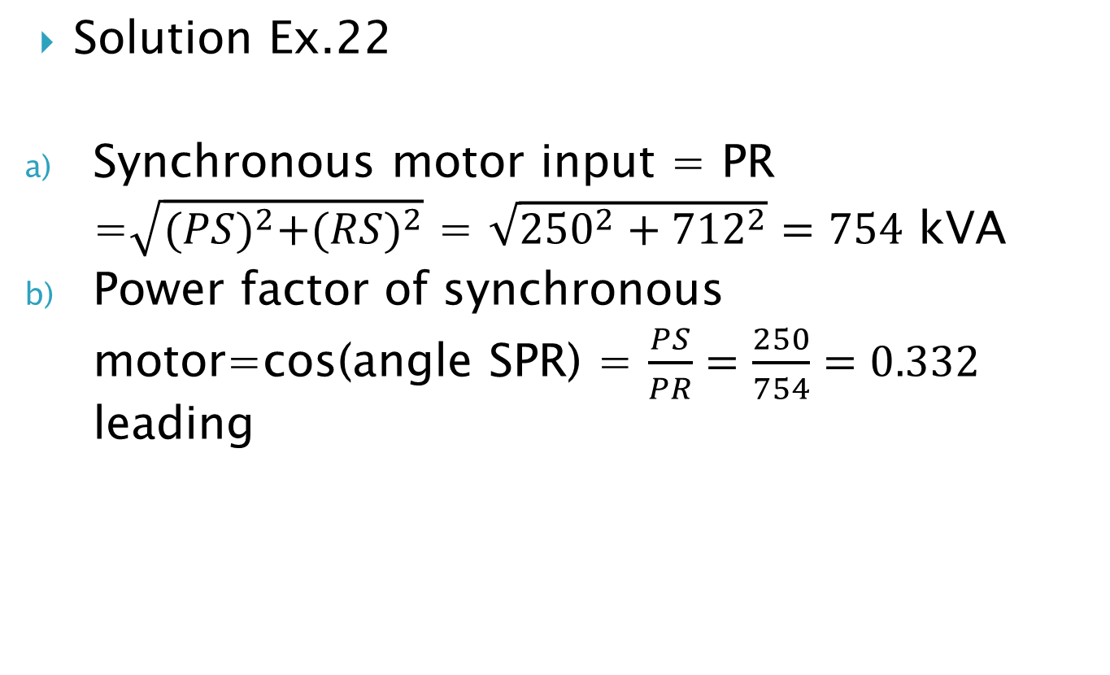
Examples on Dual-purpose Synchronous Motors
Solution Ex.22
Synchronous motor input = PR =$\sqrt{{(PS)}^{2}+{(RS)}^{2}}$ = $\sqrt{{250}^{2}+{712}^{2}}=754$ kVA
Power factor of synchronous motor=cos(angle SPR) = $\frac{PS}{PR}=\frac{250}{754}=0.332$ leading

Slide 151
Exercises on Dual-purpose SMs
The average input to a manufacturing plant is 3000 kVA at a pf of 0.72 lagging. A synchronous motor having a rating of 1300 kVA is installed for the purpose of operating a new line shaft and improving the plant pf. Assuming that the synchronous motor load is about 600 hp at an efficiency of 89.5% and that it is operated at rated kVA input, calculate a) the overall kVA load and b) the overall pf

Slide 152
Further Exercises
Exercise 9
Exercise 10
Exercise 11
Exercise 12

Slide 153
THE END

